Slide 2

Mini project-2 Batch A19
Rythu Sethu – A bridge between farmer and customer

Slide 3


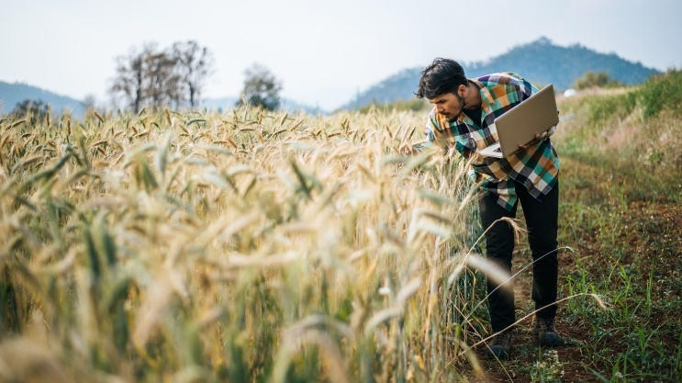
MATURI VENKATA SUBBA RAO ENGINEERING COLLEGE
NADERGUL , HYDERABAD
DEPARTMENT OF INFORMATION TECHNOLOGY
Title: RythuSethu - A bridge between farmer and customer
Batch: A19
Team Members :
K. Charan 2451-23-737-001
G. Harshith 2451-23-737-041
D. Jayanth 2451-23-737-059
Under the guidance of: A. Manasa - Assistant Professor

Slide 4
Abstract
The project creates a smart, transparent, and sustainable digital platform for modern agriculture and rural empowerment. This is a digital agriculture platform supports three main users: farmers, customers, and agents. Farmers can easily register, upload crop details, and sell products directly. Customers can search, compare, and purchase farm products online or directly from farms. Agents verify farmers, manage delivery services, and maintain system trust and quality. The platform is designed with voice-based technology and multilingual support, allowing farmers and customers to use their voice instead of typing. Machine learning, weather data, and artificial intelligence are used to predict crop demand, suggest profitable crops, and help farmers plan cultivation based on season and market trends. Smart delivery routing reduces transportation cost and time. Community group buying reduces delivery cost for customers. A trust-based system helps identify reliable farmers.

Slide 5
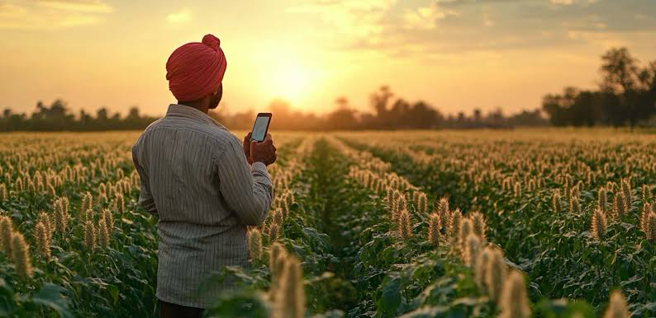

Slide 6
Introduction
This project is aimed to solve major problems faced by farmers and customers by creating a platform that connects them directly.Farmers often face low profits, middlemen dependency, and lack of market access, while customers struggle to find fresh and affordable farm products. This system uses machine learning to provide weather-based crop suggestions, price prediction, and demand analysis. It includes an AI farmer assistant that gives farming guidance through voice in local languages. Voice technology allows farmers to upload crop details and receive updates without typing. The platform also offers smart delivery routing, farmer trust scores, and community group buying to reduce costs. This system helps increase farmer income, reduce food waste, provide fresh food to customers, and support rural digital growth while making agriculture smarter and more transparent.

Slide 7
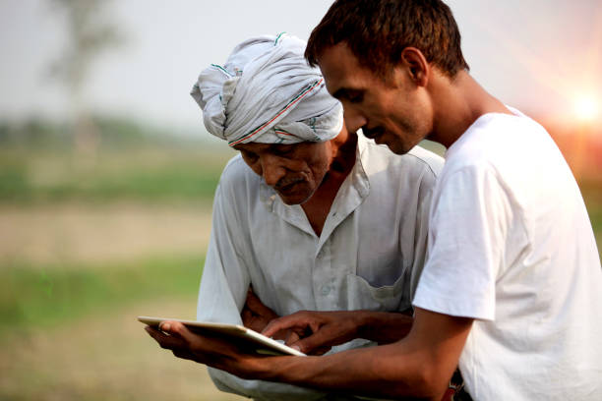
Problem Statement
To develop a digital platform that directly connects farmers and customers to enable fair farmer earnings while providing customers with affordable organic food without intermediaries.

Slide 8
Literature survey
S.No | Author | Year | Title | Modules Covered | Key Points | Adopted Features | Limitations
1 | I. Rahman, Riyazulla | 2024 | Farm to Fork | Farmer, Customer, Market | Digital farm marketplace | Farmer-consumer platform | No AI support
2 | Univ. of Washington | 2020 | Farm-to-Table System | Farmer, Customer, Admin, Delivery | Organized supply chain | Delivery tracking | Region specific
3 | S. G. Yogesh, D. S. Ravindran | 2023 | Organic Sales Profitability | Farmer, Customer, Admin | Improves farmer income | Direct digital sales | Literacy issues
4 | S. Pudumalar et al. | 2017 | Crop Recommendation | Farmer, Recommendation | Soil-based crop selection | ML recommendation | Limited dataset
5 | N. H. Kulkarni et al. | 2018 | Crop Productivity | Farmer, Analytics | Improves productivity | Ensemble learning | No real-time support
6 | Y. J. N. Kumar et al. | 2020 | Crop Yield Prediction | Farmer, ML Engine | Predicts crop yield | Yield forecasting | Data dependent
7 | N. Shirisha et al. | 2024 | Multilingual Farming | Farmer, Voice Module | Supports native languages | NLP assistance | Translation errors
8 | S. Sultana et al. | 2025 | Organic Farming Landscape | Farmer, Market | Studies market trends | Buyer insights | Limited implementation

Slide 9
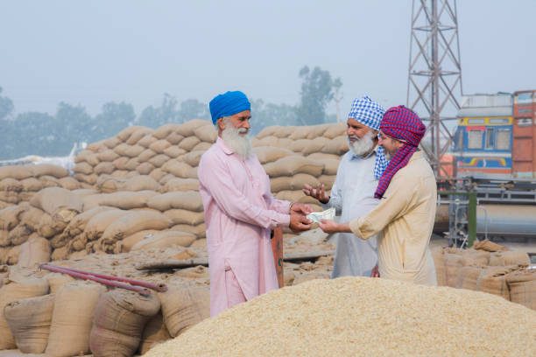
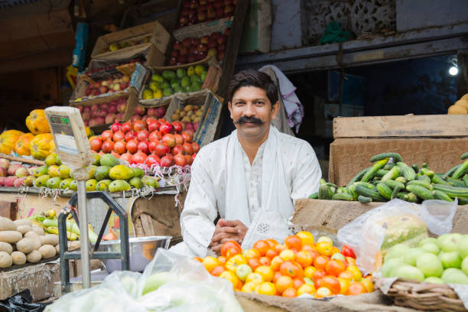
Existing System
In the current agricultural market system, farmers usually depend on intermediaries such as wholesalers,greengrocers , vendors and retailers to sell their products.
Customers purchases the goods as per the price decided by those vendors.
Farmers also lack access to real-time demand data, weather-based crop planning and direct customer feedback, which affects their income stability and production decisions.
Drawbacks :
Farmers often receive lower prices, while customers pay higher prices due to added transportation, storage, and vendor profit margins.
There is also limited transparency about product freshness, organic quality and source of origin.

Slide 10

Proposed System
This is a smart digital platform that directly connects farmers and customers.
It removes middlemen and ensures fair pricing for farmers and affordable organic products for customers.
The platform uses machine learning for demand prediction, crop suggestions and weather-based farming guidance.
It includes voice-based multilingual support for easy access by rural farmers.
Additional features include AI farmer assistant, smart delivery routing,trust score for farmers, and community group buying to reduce costs further.

Slide 11
Module split up
Admin :
Identifies and selects trustworthy and dependable farmers.Handles and manages suggestions from both farmers and customers.
Farmer :
Adds and manages product details for sale such as price, quantity, and location.Checks recommendations and suggestions provided by the agent for better farming practices and improved income.
Customer :
Searches for the desired items from farmers and can find the location of fresh farm products.
Can view details about any offers or suggestions provided by the agent.
Agent :
Collects farm products from farmer and delivers to customers directly

Slide 12
Hardware Requirements:
Development Hardware : Laptop or Desktop Computer
Processor: Intel i5 / AMD Ryzen 5 or higher RAM: 8 GB minimum Storage: 256 GB SSD
Server Hardware (For Real Deployment), Smartphones (Android / iOS) Tablets Desktop browsers Devices
Cloud Server / VPS CPU: 2 vCPUs RAM: 4 GB Storage: 50 GB SSD Network: High-speed internet
Software Requirements :
Operating System: Windows 10 / Windows 11 macOS Linux (Ubuntu recommended)
Development Tools :Visual Studio Code ,Git, Node.js, npm
Frontend And BackendTechnologies : React HTML5 CSS3 JavaScript Tailwind CSS ,Node.js Express.js
Database:MongoDBCompass (Primary database) MongoDB Atlas (Cloud database option)
APIs and Integrations : Google Maps Platform – Location and delivery routing Web Speech API – Voice input and voice commands Open-Meteo – Weather based crop suggestions Twilio – SMS verification SendGrid – Email verification
Machine Learning Tools Python Scikit-learn TensorFlow
Deployment Platforms: Vercel – Frontend hosting Render – Backend hosting GitHub – Source code repository
Web Browser Support Google Chrome Mozilla Firefox Microsoft Edge

Slide 13
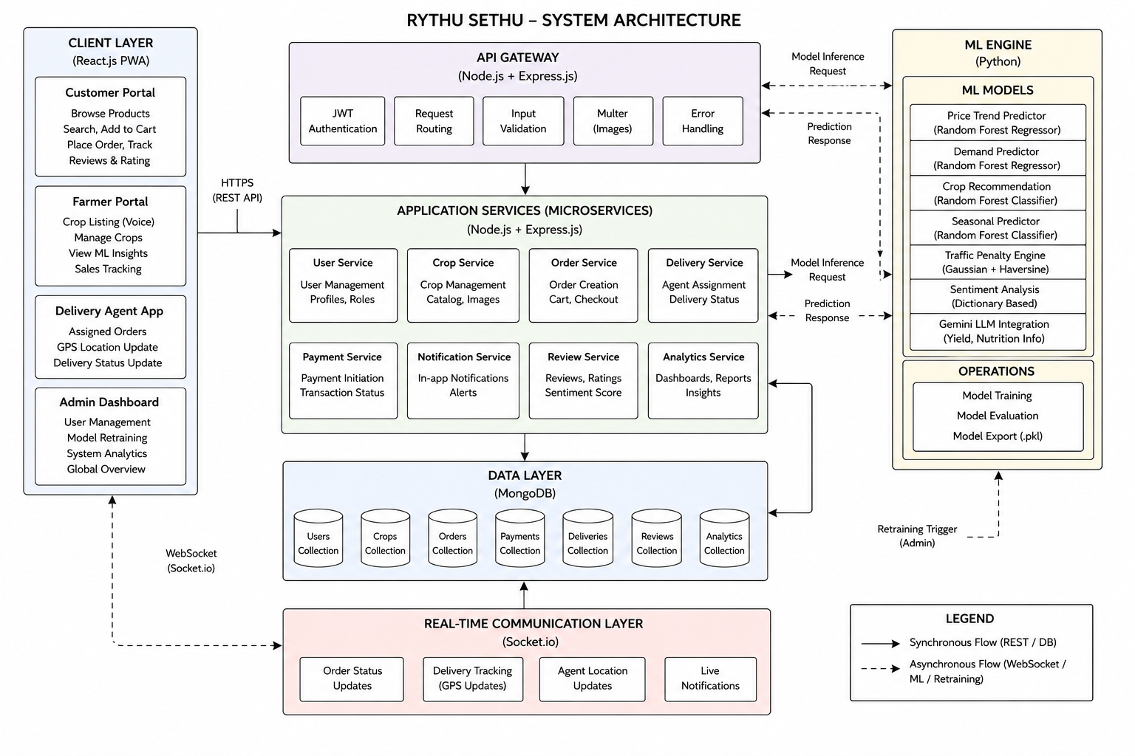
System Architecture

Slide 14
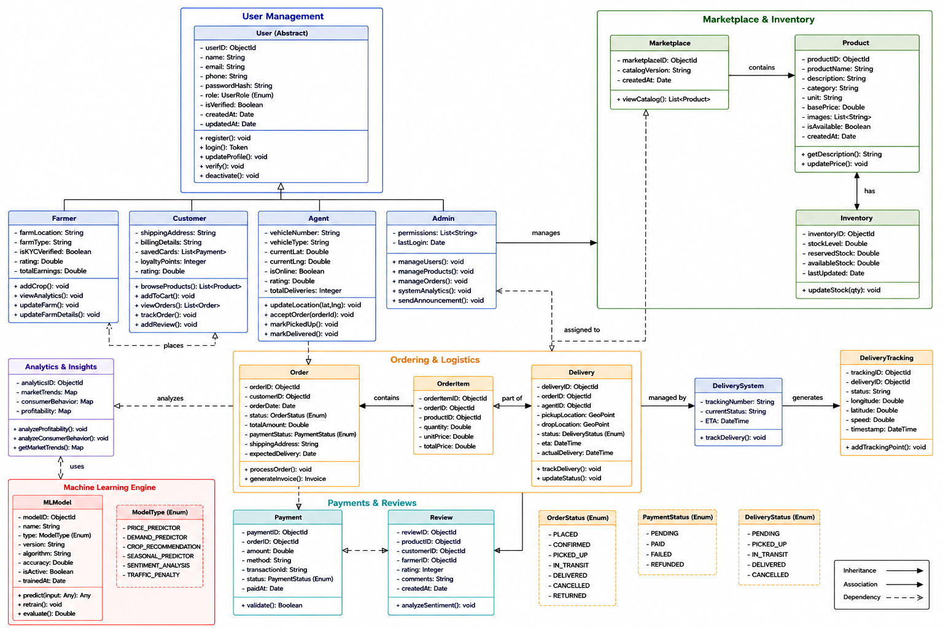
Class diagram

Slide 15
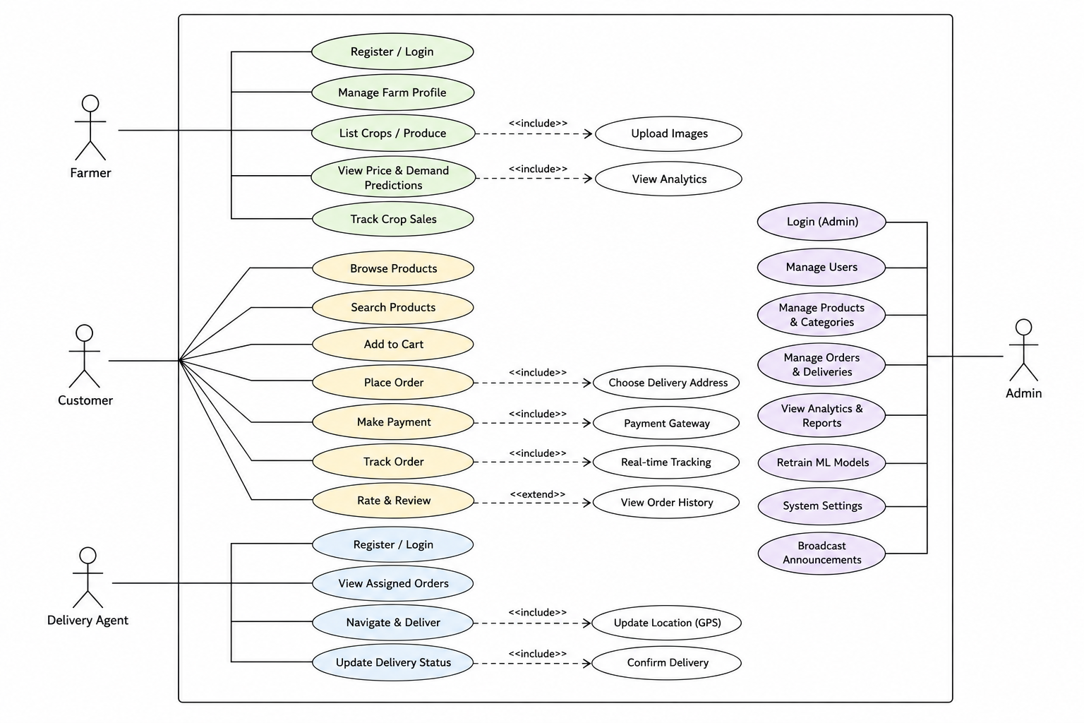
Use case diagram

Slide 16
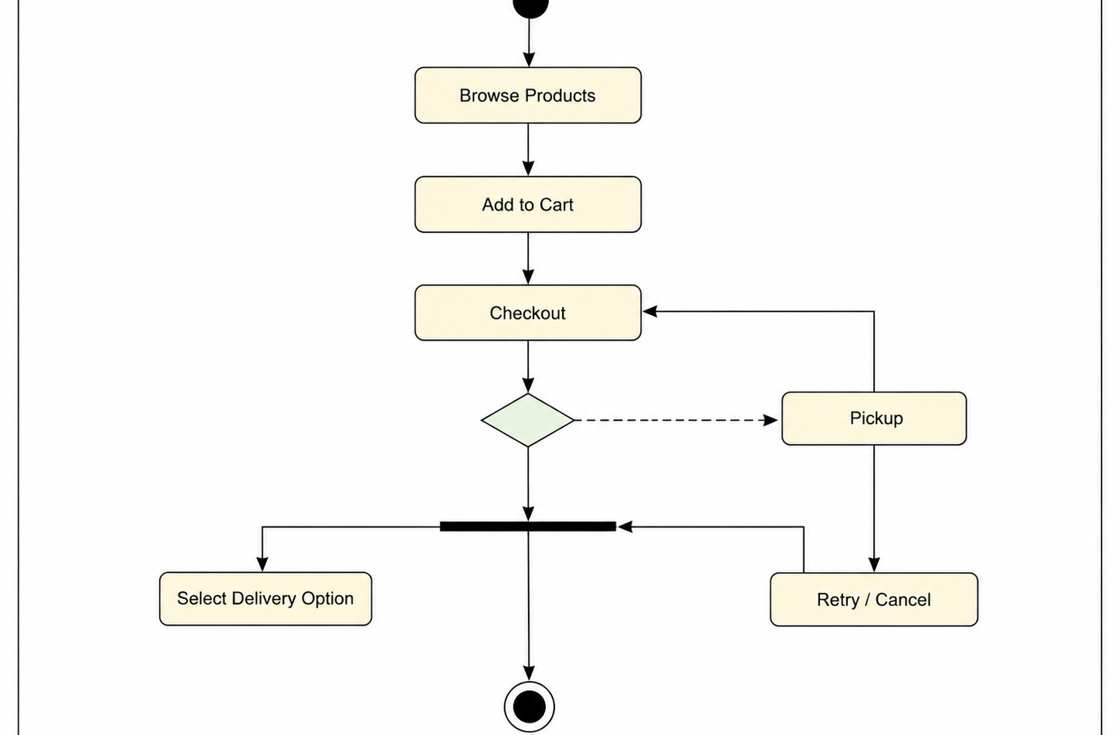
Activity diagram

Slide 17
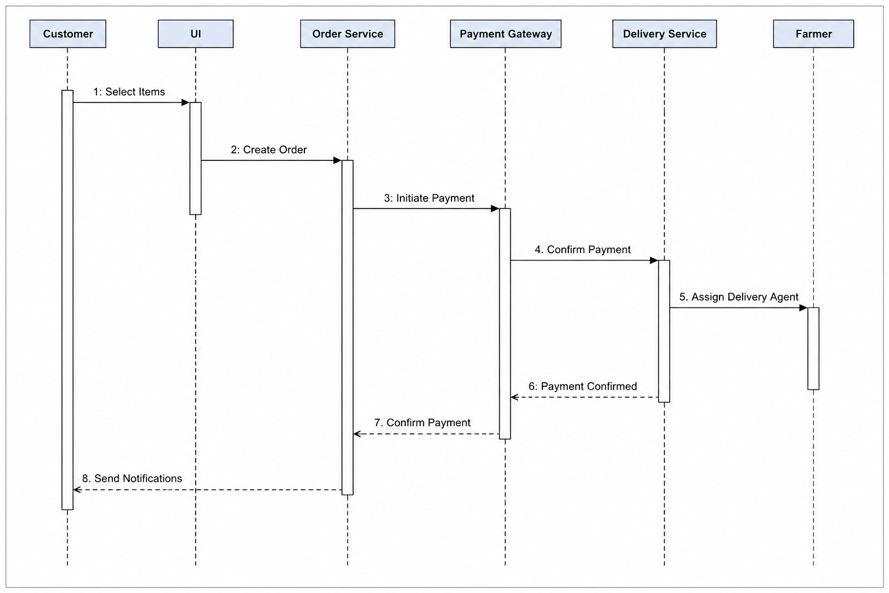
Sequence diagram

Slide 18

Implementation
Use V S Code to implement this web project
As it as a MERN based project there are three terminals to be used in the project directory
In backend npm start
Frontend npm run dev
Mongod

Slide 19
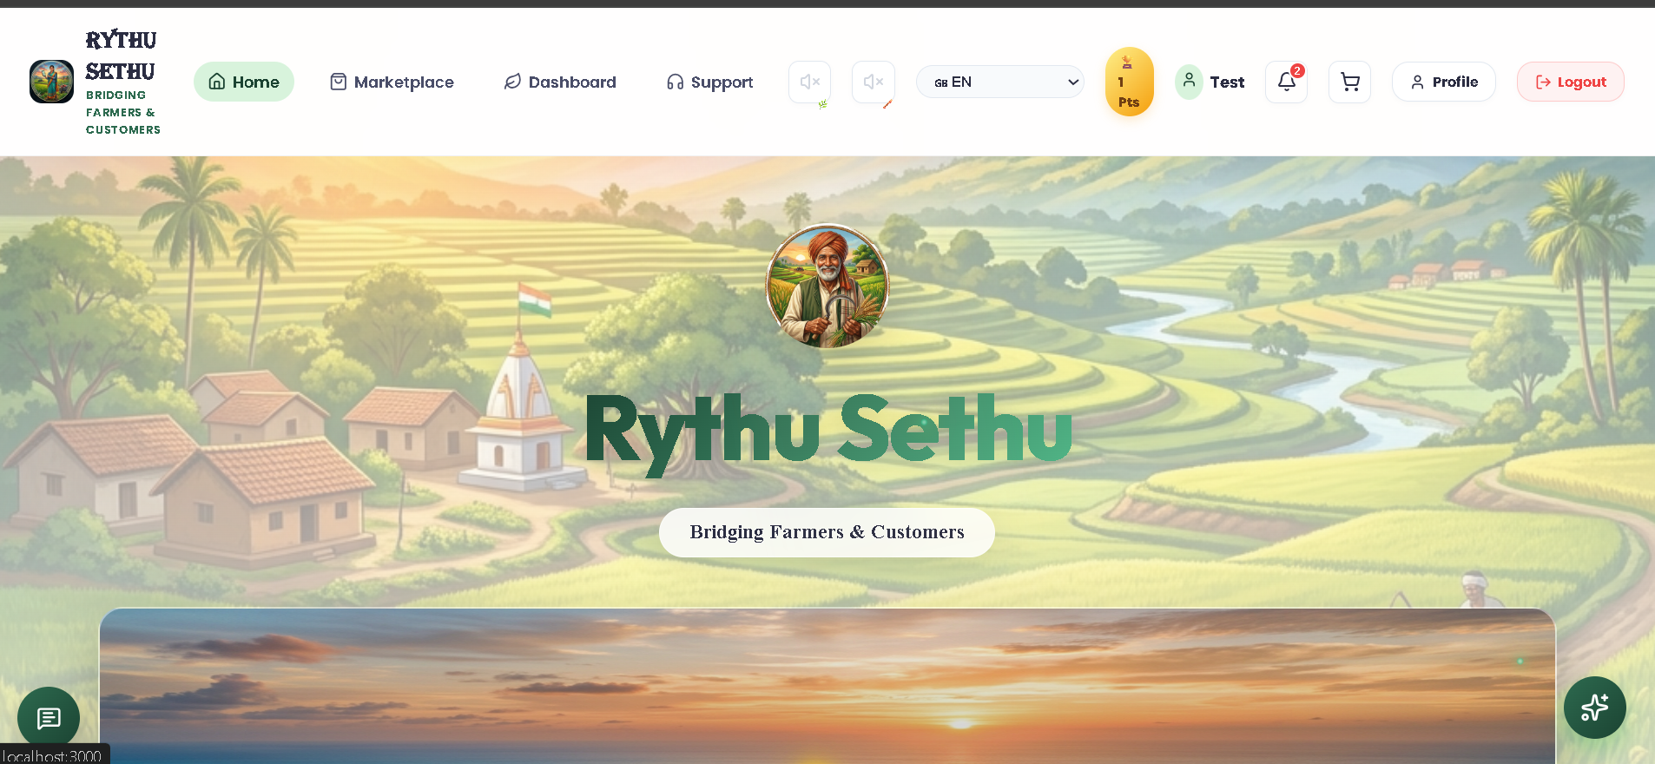
Result

Slide 20
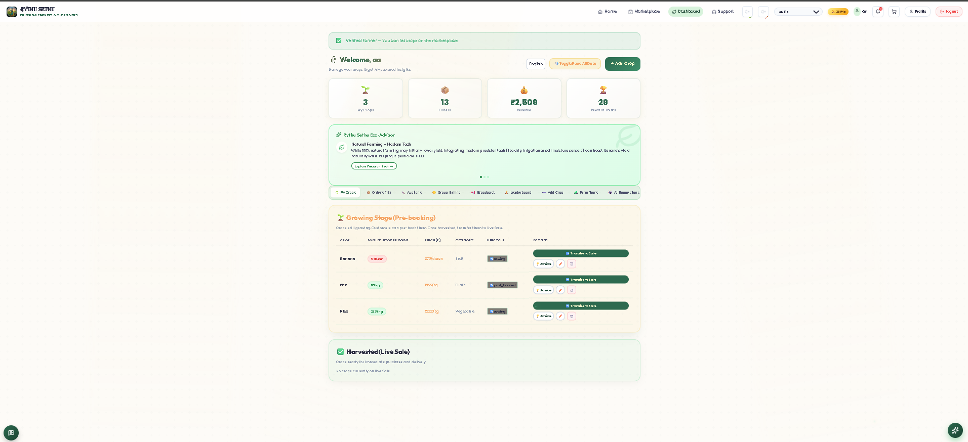
Result

Slide 21
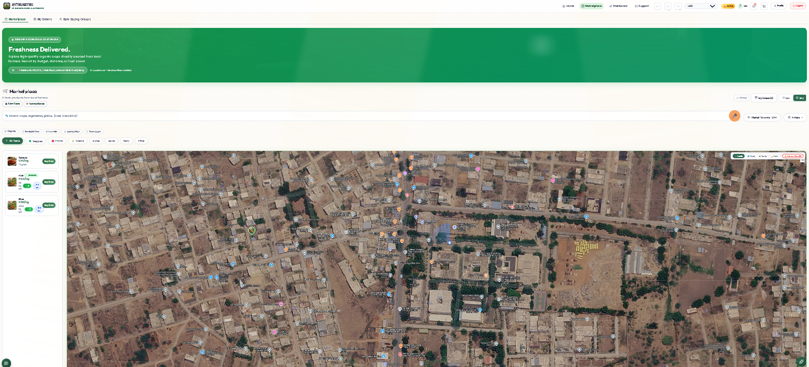
Result

Slide 22
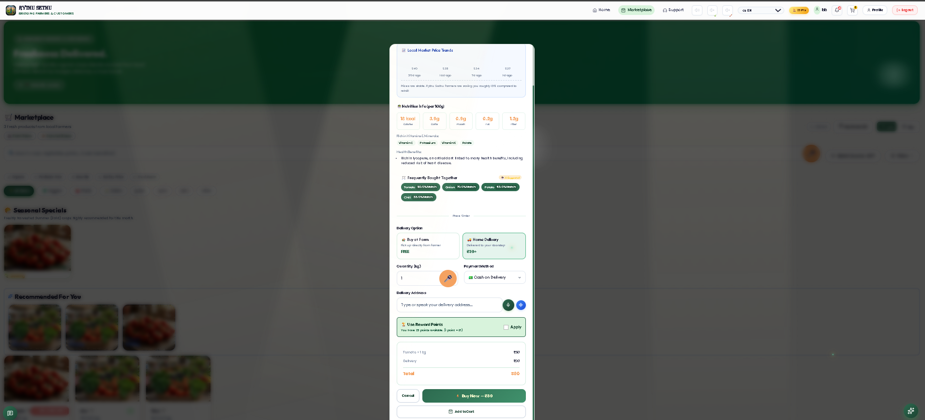
Result

Slide 23
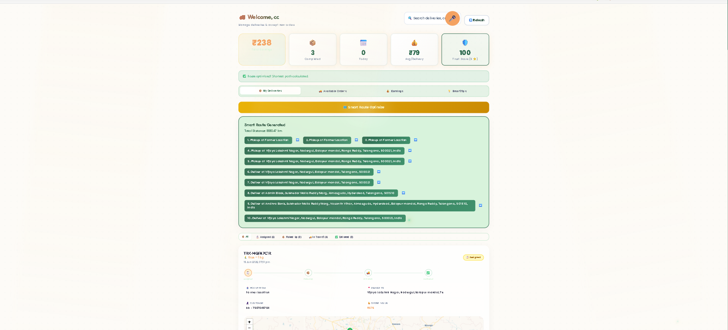
Result

Slide 24
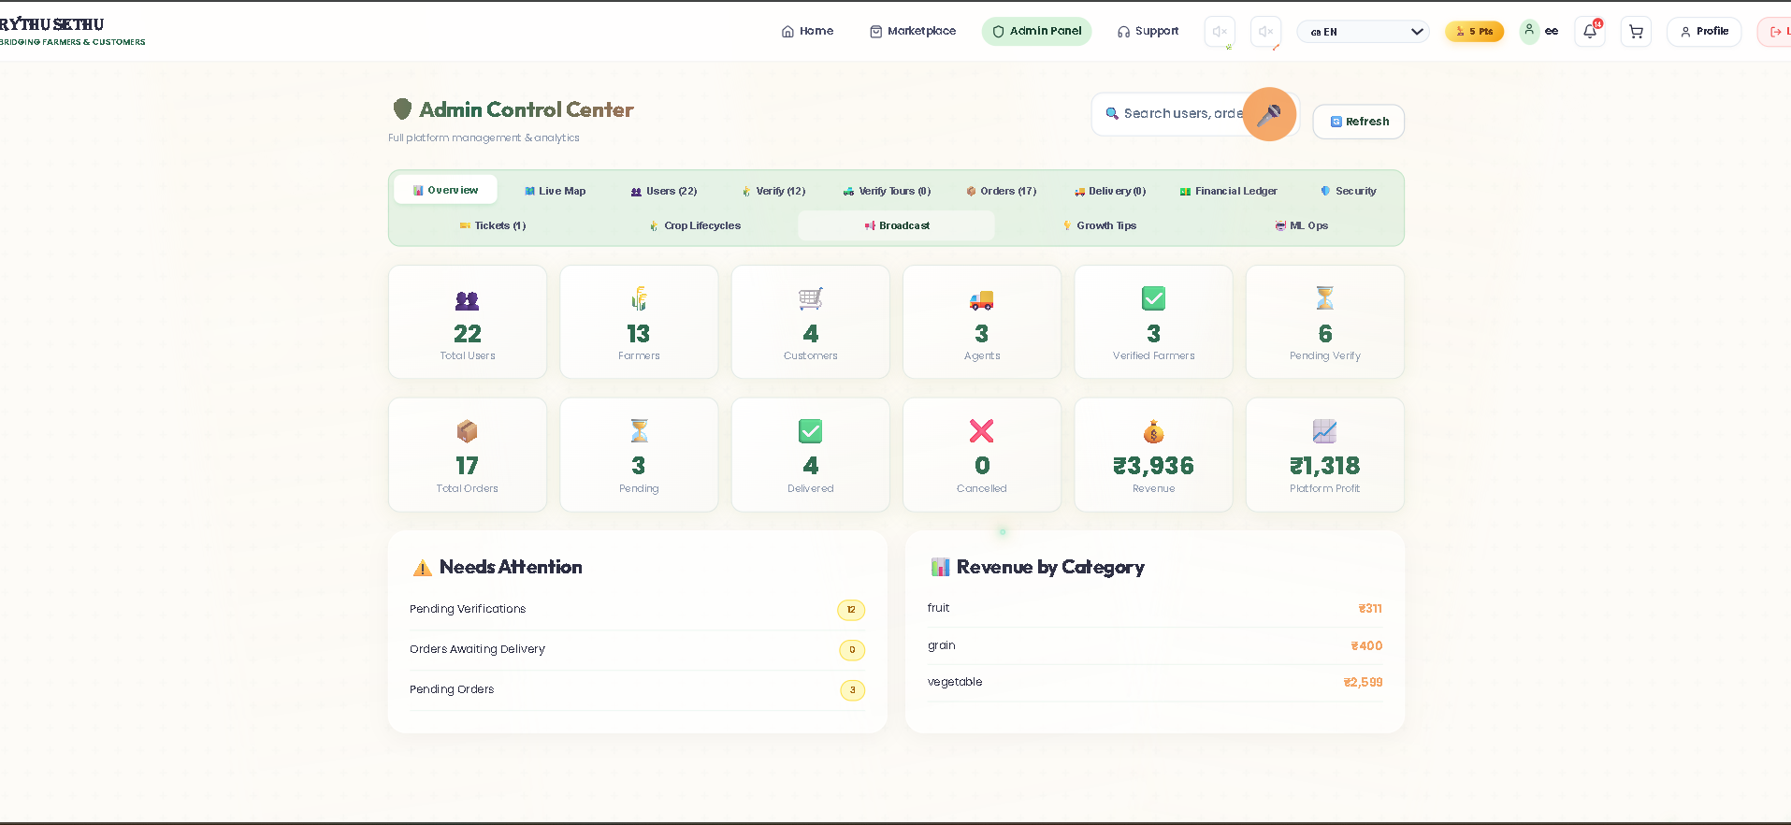
Result

Slide 25
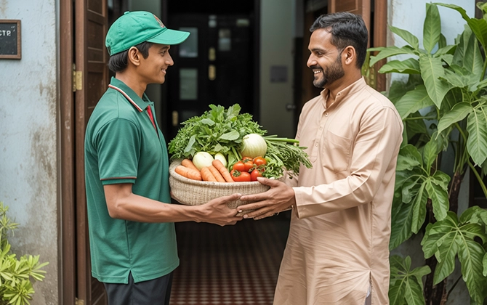
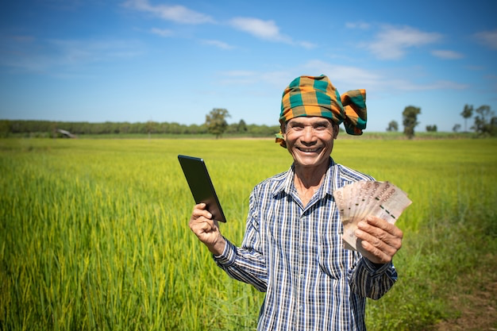
Conclusion
This system creates a transparent, technology-driven agricultural marketplace that benefits both farmers and customers. It increases farmer profits, provides affordable organic food. By combining AI, voice technology, and smart logistics. This platform builds a sustainable, trusted, and future-ready farming ecosystem.

Slide 26
References
[1] I. Rahman and Riyazulla, “Farm to Fork,” International Journal of Scientific Research in
Engineering and Management (IJSREM), vol. 8, pp. 1–6, 2024, doi: 10.55041/IJSREM28019.
[Online]. Available: https://doi.org/10.55041/IJSREM28019
[2] University of Washington Food Systems Program, “Farm-to-Table System Design,”
University of Washington, Seattle, WA, USA, 2020. [Online]. Available:
https://depts.washington.edu/f2w/wp-content/uploads/2020/09/Farm-to-Table-
NTR631_FinalReport_March-2020.pdf
[3] S. G. Yogesh and D. S. Ravindran, “Profitability through Organic Sales,” Agronomy, vol. 13,
no. 5, 2023. [Online]. Available: https://www.mdpi.com/2073-4395/13/5/1200
[4] S. Sultana, B. Barman, R. Singh, and P. K. Velayudhan, “Organic Farming Research
Landscape,” Discover Agriculture, Springer Nature, vol. 2, 2025. [Online]. Available:
https://link.springer.com/article/10.1007/s43621-025-01306-6
[5] G. Biau, “Analysis of a Random Forests Model,” Journal of Machine Learning Research,
vol. 13, pp. 1063–1095, 2012. [Online]. Available:
https://www.jmlr.org/papers/v13/biau12a.html
[6] S. Pudumalar, E. Ramanujam, R. H. Rajashree, C. Kavya, T. Kiruthika, and J. Nisha, “Crop
recommendation system for precision agriculture,” in Proc. 8th Int. Conf. on Advanced Computing
(ICoAC), Chennai, India, 2017, pp. 32–36, doi: 10.1109/ICoAC.2017.7951740.
[Online]. Available: https://ieeexplore.ieee.org/document/7951740

Slide 27
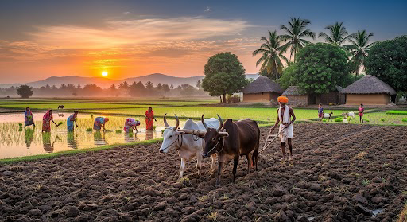
Let us make this true
Rythu Devo Bhava

Slide 28

Thank You
Any Queries ?

